Slide 1
Suomi NPP ATMS SDR Provisional Product Highlights
Fuzhong Weng, ATMS SDR Team Managerial Lead (Acting)
Suomi NPP SDR Product Review
NOAA Center for Weather and Climate Prediction (NCWCP)
5830 University Research Park, College Park, Maryland
October 23 - 24, 2012

Slide 2
Outline
Team Membership
ATMS calibration requirements
ATMS calval task network
Provisional product highlights
Lessons Learned and path forward
Summary

Slide 3
ATMS Team Membership
PI Name | Organization | Team Members | Funding Agency | FY13 Task
Fuzhong Weng | NOAA/STAR | N. Sun, T. Mo, X. Zou, Lin Lin, Li Bi | NJO | Support NPP/J1 Calval
Edward Kim | NASA | Joseph Lyu | NJO | Support NPP/J1 Calval
William Blackwell | MIT/LL | V. Leslie, C. Cull, I. Osaretin, R. Czerwinski, J. Samra, M. Tolman | NJO | Support NPP/J1 Calval
Neal Baker | DPA | M. Denning | NJO | Support NPP/J1 Calval
Kent Anderson | NGES | M. Landrum | NASA | Support NPP/J1 Calval
Degui Gu | NGAS | A. Foo, G. Amici | NASA | Support Transition
Wael Ibrahim | Raytheon |  | NASA | Support NPP/J1 Calval
Kris Robinson | USU/SDL |  | NJO | Support NPP/J1 Calval

Slide 4
ATMS Calibration Requirements
# | Channel Freq.(MHz) | Polarization | Bandwidth Max. (MHz) | Freq. Stability (MHz) | Calibration Accuracy | Nonlinearity Max. (K) | NEΔT (K) | 3-dB BW* (deg)
1 | 23800 | QV | 270 | 10 | 0.83 | 0.1 | 0.5 | 5.2
2 | 31400 | QV | 180 | 10 | 0.83 | 0.1 | 0.6 | 5.2
3 | 50300 | QH | 180 | 10 | 0.67 | 0.075 | 0.7 | 2.2
4 | 51760 | QH | 400 | 5 | 0.67 | 0.075 | 0.5 | 2.2
5 | 52800 | QH | 400 | 5 | 0.67 | 0.075 | 0.5 | 2.2
6 | 53596±115 | QH | 170 | 5 | 0.67 | 0.075 | 0.5 | 2.2
7 | 54400 | QH | 400 | 5 | 0.67 | 0.075 | 0.5 | 2.2
8 | 54940 | QH | 400 | 10 | 0.67 | 0.075 | 0.5 | 2.2
9 | 55500 | QH | 330 | 10 | 0.67 | 0.075 | 0.5 | 2.2
10 | f_{o}=57290.344 | QH | 330 | 0.5 | 0.67 | 0.075 | 0.75 | 2.2
11 | f_{o} ± 217 | QH | 78 | 0.5 | 0.67 | 0.075 | 1.0 | 2.2
12 | f_{o} ±322.2±48 | QH | 36 | 1.2 | 0.67 | 0.075 | 1.0 | 2.2
13 | f_{o} ±322.2±22 | QH | 16 | 1.6 | 0.67 | 0.075. | 1.5 | 2.2
14 | f_{o} ±322.2±10 | QH | 8 | 0.5 | 0.67 | 0.075 | 2.2 | 2.2
15 | f_{o} ±322.2±4.5 | QH | 3 | 0.5 | 0.67 | 0.075 | 3.6 | 2.2
16 | 88200 | QV | 2000 | 200 | 0.95 | 0.1 | 0.3 | 2.2
17 | 165500 | QH | 3000 | 200 | 0.95 | 0.1 | 0.6 | 1.1
18 | 183310± 7000 | QH | 2000 | 30 | 0.95 | 0.1 | 0.8 | 1.1
19 | 183310± 4500 | QH | 2000 | 30 | 0.95 | 0.1 | 0.8 | 1.1
20 | 183310± 3000 | QH | 1000 | 30 | 0.95 | 0.1 | 0.8 | 1.1
21 | 183310± 1800 | QH | 1000 | 30 | 0.95 | 0.1 | 0.8 | 1.1
22 | 183310± 1000 | QH | 500 | 30 | 0.95 | 0.1 | 0.9 | 1.1

Slide 5
ATMS CalVal Task Network
Index | Organizations | Task Name/Number | Objective
#1 | MITLL(S) NGES(P) NASA(S) | ATMS Activation sequence / SEV-1 | Activate ATMS by safely powering up, initiating a scan profile, and to start collecting science packet data
#2 | NOAA/STAR(P) | ATMS Long Term Trending / SEV-2 | Trend a multitude of ATMS data to monitor the health, anomalies, and the response of external influences on the instrument
#3 | MITLL(S) NGES(P) NASA(S) | ATMS Functional Evaluation | Evaluate that the sensor is operating as expected and was undamaged during the launch phase
#4 | NOAA/STAR(CP) MITLL(CP) NASA(CP) | ATMS Space View Sector Selection / TUN-1 | Determine which of the pre-determined space view angles have the least interference from the spacecraft or Earth intercept
#5 | MITLL(CP) NASA(CP) | ATMS NPP intra-satellite interference evaluation / SEV-4 | Determine ATMS RFI susceptibility to instruments and transmitters on NPP
#6 | MITLL(CP) NASA(CP) | ATMS NPP Terrestrial Interference Evaluation / SEV-5 | Identify RFI from ground sources
#7 | MITLL(S) NGES(P) NASA(S) | ATMS Dynamic Range Evaluation / SEV-6 | Verify that the radiometric counts do not exceed the specified maximum allowable for the instrument’s Analog-to-Digital conversion
#8 | MITLL(S) NGES(P) NASA(S) | ATMS Scan Angle Evaluation / SEV-7 | Verify that the reflector’s scan position in the science data packet matches the expected scan position
#9 | NOAA/STAR(S) NGES(P) MITLL(S) NASA(S) | ATMS Radiometric Sensitivity Evaluation / VER-1 | Evaluate the on-orbit radiometric sensitivity (NE∆T)
#10 | NOAA/STAR(S) NGES(P) MITLL(S) NASA(S) | ATMS Temperature Stabilization / SEV-8 | Allow the sensor’s temperature to reach equilibrium
#11 | MITLL(CP) NASA(CP) | ATMS RF Shelf to Cold Plate LUT Verification / TUN-2 | Verify the SDR algorithm LUT then covert the RF Shelf temperature to an appropriate cold plate temperature. Such LUT is used to determine the nonlinearity correction factor based on the present RF Shelf temperature
#12 | MITLL(CP) NASA(CP) | ATMS Performance Evaluation: Short Stare & Dwell Test / TUN-x | Evaluate sensor performance through the sensor’s Power Spectral Density (PSD)
#13 | MITLL(CP) NASA(CP) | ATMS Radiometric Environmental Characterization / TUN-y | Characterize the radiometric environment to validate the cold calibration temperature bias (SDR algorithm calibration parameter), evaluate the uniform weight of the four internal calibration target measurements, and provide additional measurements to the calculation of the beam efficiency and scan bias correction factors (SDR algorithm calibration parameters).
#14 | NOAA/STAR(CP) NASA(CP) | ATMS Lunar Intrusion Evaluation and Mitigation / TUN-3 | Determine a routine procedure for dealing with lunar contamination of the cold space calibration target

Slide 6
ATMS CalVal Tasks
Index | Organizations | Task Name/Number | Objective
#15 | NOAA/STAR(S) MITLL(P) NASA(S) | Roll/Pitch Maneuvers / TUN-4, TUN-5, TUN-6 | Characterize the cross-track scan bias dependence and determine at least part of any asymmetries that may exist toward the anti-sun side of the bus
#16 | NOAA/STAR(S) SDL(P) | Geolocation Verification / VER-2 | Evaluate the pitch, roll, and yaw accuracy of the native ATMS FOVs
#17 | MITLL(P) | ATMS Central Frequency Stability / SEV-9 | Verify the frequency stability of the opaque 57.29-GHz channels
#18 | NOAA/STAR(P) MITLL(S) | SDR Correction Analysis / TUN-7 | Calculate the two SDR tunable parameters called the beam efficiency and scan-dependent bias correction factors
#19 | NOAA/STAR(S) MITLL(P) | ATMS Resampling Validation using CrIS / VER-3 | Validate the ATMS FOV resampling to the CrIS FOR
#20 | NOAA/STAR(P) | Ascend/Descend comparisons / VER-4 | Determine pointing, navigation, and asymmetry errors by binned and averaged 0.5x0.5 lat-lon boxes for ascending and descending nodes
#21 | NOAA/STAR(P) NASA(S) | Simultaneous Nadir Overpass (SNO) / VER-5 | Inter-calibrate polar orbiting radiometers across satellites to achieve the consistency and traceability required for long term climate studies from the more than 20 years of NOAA satellite data. In addition, the calibration of current operational radiometers should be linked to those of the next generation meteorological satellites such as NPOESS
#22 | NOAA/STAR(P) | Double Difference / VER-6 | Inter-calibrate polar orbiting radiometers across satellites.
#23 | NOAA/STAR(S) SDL(P) MITLL(S) | ATMS SDR validation by RAOB / VER-7 | Assemble a “golden set” of a few hundred matchups of Radiosonde and CrIMSS FOR’s over clear-sky area and validate ATMS SDR
#24 | NOAA/STAR(P) MITLL(S) | ATMS SDR validation by NWP / VER-8 | Identify SDR and remap SDR bias using NCEP GFS/GDAS data
#25 | MITLL(P) NASA(S) | High-Altitude Aircraft Validation Campaigns / VER-9 | Compare high-resolution and high altitude aircraft brightness temperature images with those from coincident satellite overpasses.

Slide 7
ATMS SDR Provisional Product Highlights
Stable instrument performance and calibration
All the ATMS channels have noises much lower than specification
ATMS processing coefficients table (PCT) are updated with nominal values
Quality flags (e.g. spacecraft maneuver and scanline, calibrations) are checked and will be updated in the MX7.0
Geolocation errors for all the channels are quantified and meet specification
Remap SDR coefficients are updated using on-orbit CrIS data (e.g. CrIMSS now fully synchronized) and RSDR biases are assessed
On-orbit absolute calibration is explored using GPS RO data, LBLRTM and ATMS SRF. All the sounding channels have biases much less than specification of accuracy
A theory for converting from DR to SDR is fully developed and tested for ATMS. ATMS scan bias correction coefficients are derived.

Slide 8
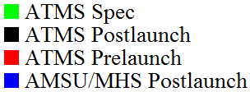
Channel Noise Characterization
NEΔT (K)
Channel Number
All Channels are within Specifications
Slide courtesy of STAR

Slide 9
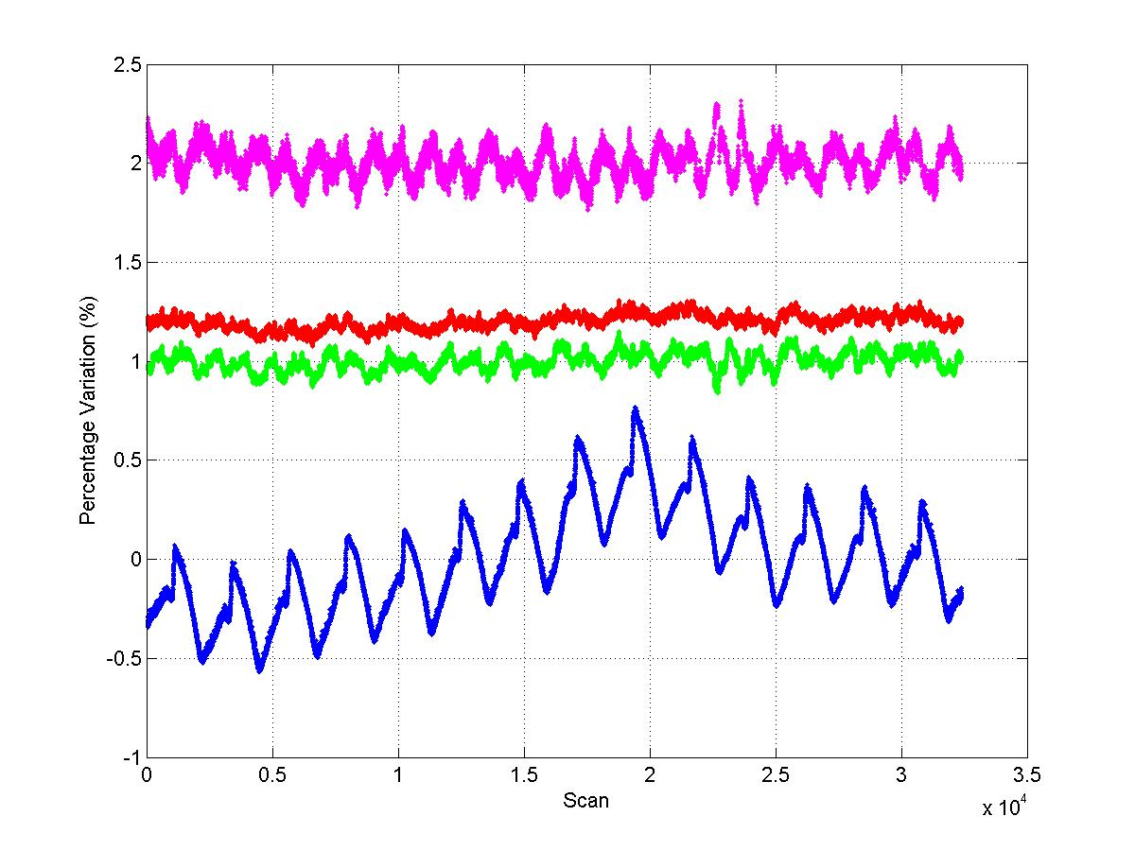
Calibration Target Consistency Check
GAIN Variability (%). Shifted 2%
Warm (R) and Cold (G) Counts Variability (%). Shifted 1-1.2%
PRT Temperature Variability (%)
ATMS calibration data consistency check. Channel 16. Nov 18, 2011. Data downloaded from GTP. Cold counts have more variability than warm counts, and gains also show significant variability. Need further investigation and assessment of impact on SDR quality
Slide courtesy of NGAS

Slide 10
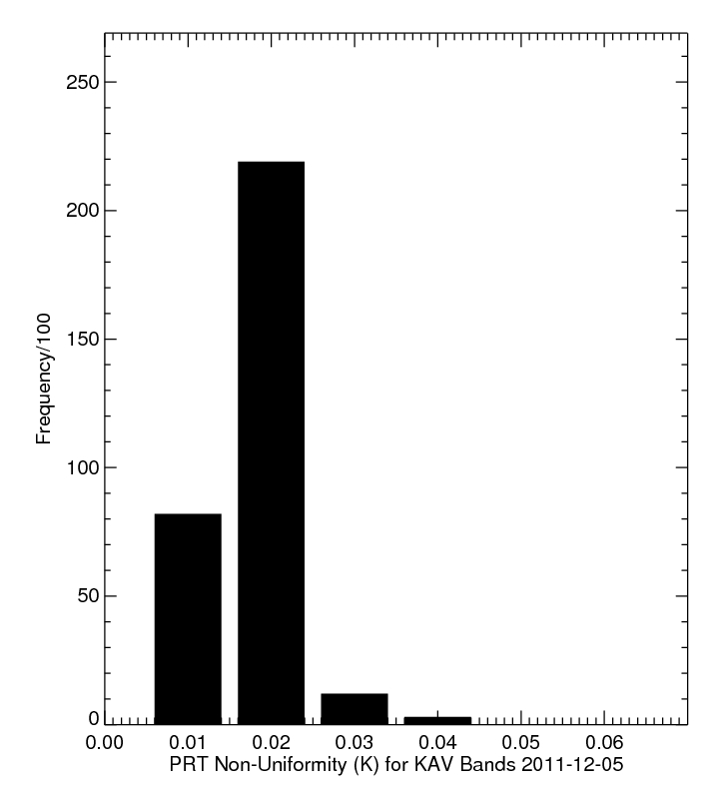
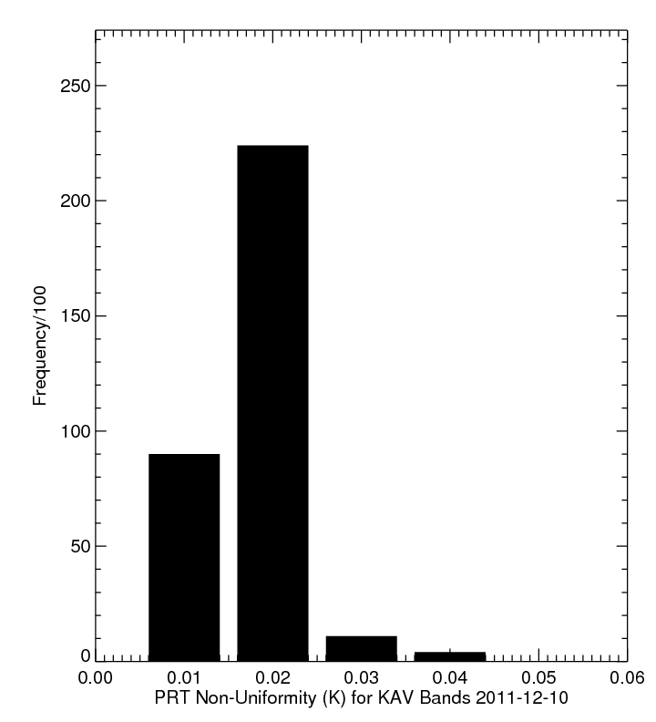
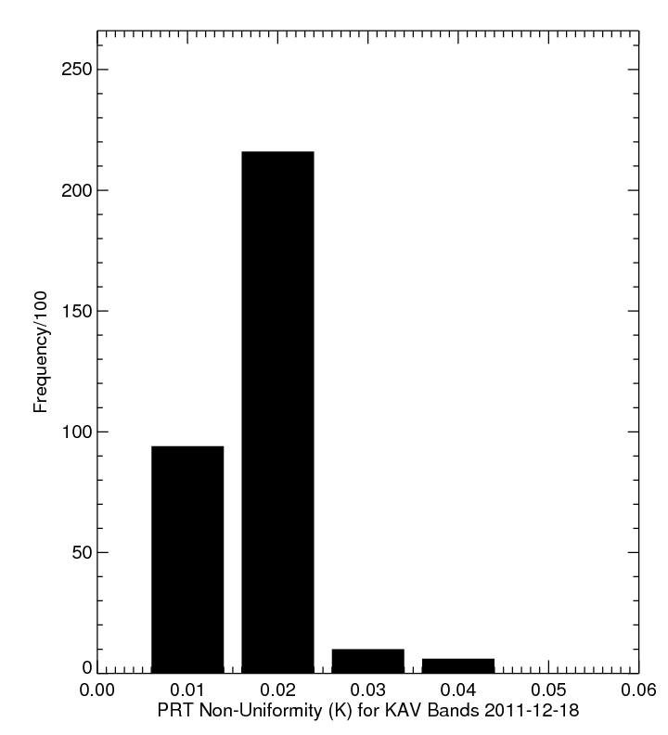
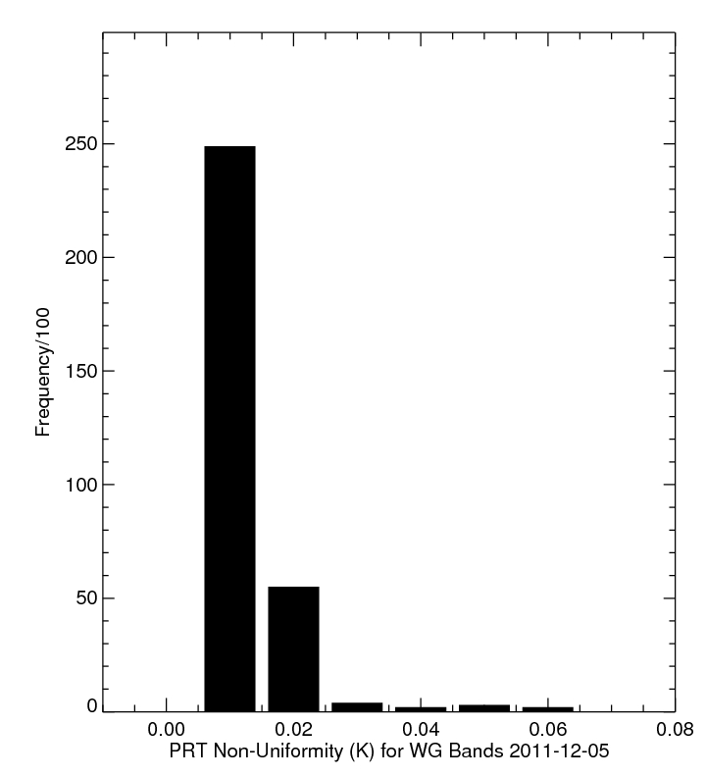

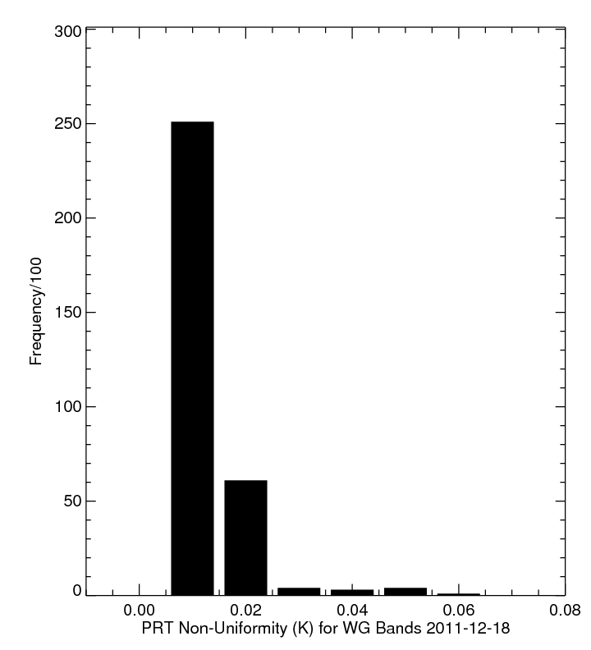
ATMS PRT Uniformity Check
12-05-2011
12-10-2011
12-18-2011
PRT-KAV
= 0.02K
PRT-KAV
=0.02K
PRT-KAV
=0.02K
PRT-WG
= 0.015K
PRT-WG
= 0.015K
PRT-WG
= 0.015K
Slide courtesy of STAR

Slide 11
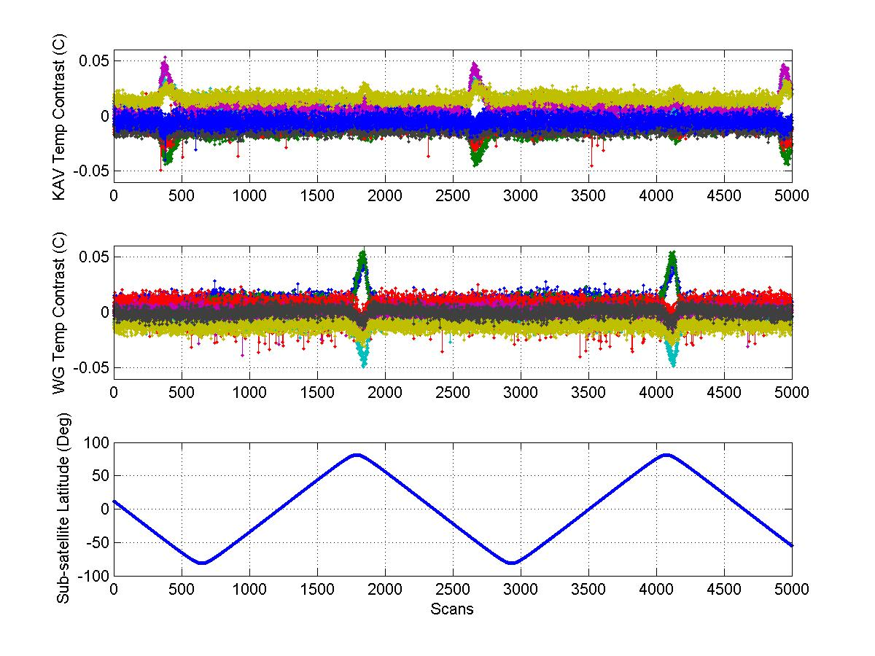
PRT Temperature Uniformity Check
Warm load PRT temperature contrast spiked around the north pole for the WG bands. Similar spikes occurred at ~45 degree south for the KAV bands
Slide courtesy of NGES

Slide 12
ATMS Dynamic Range Count (Warm)
Dynamic range is assessed by comparison to requirement that maximum allowable radiometric counts, for any channel, shall be < 45,150
The dynamic range assessment is done by extrapolating the warm target counts to a 330 K temperature, using gains computed from on-orbit data.
As shown in chart, for orbit 163, all channels consistently met the criterion that counts (330K) < 45,150. Over 13,100 counts margin relative to 45,150 limit. Dynamic range requirements are satisfied
Slide courtesy of NGES

Slide 13
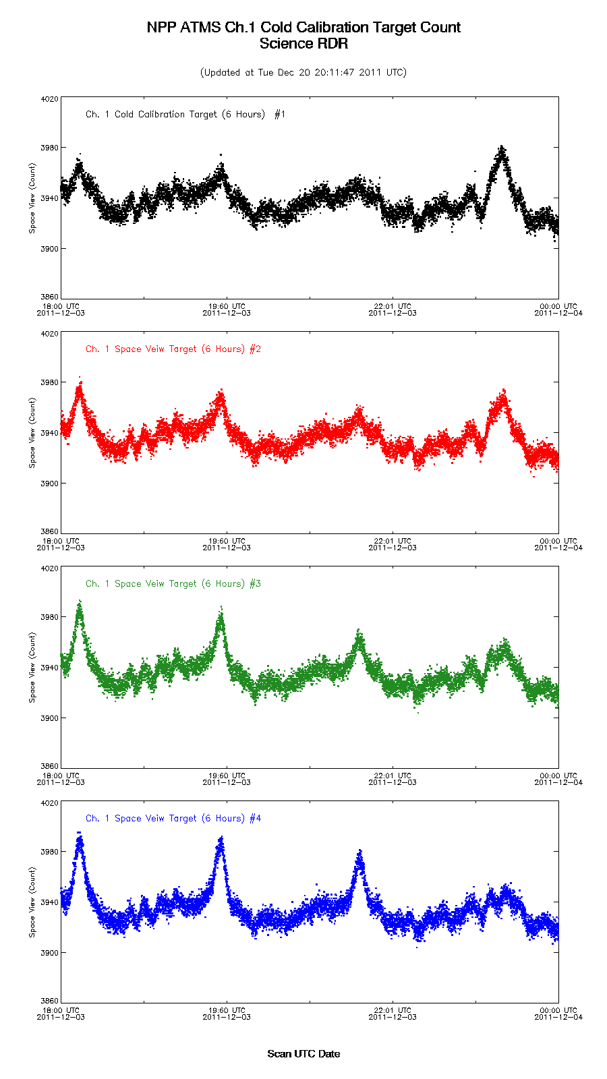
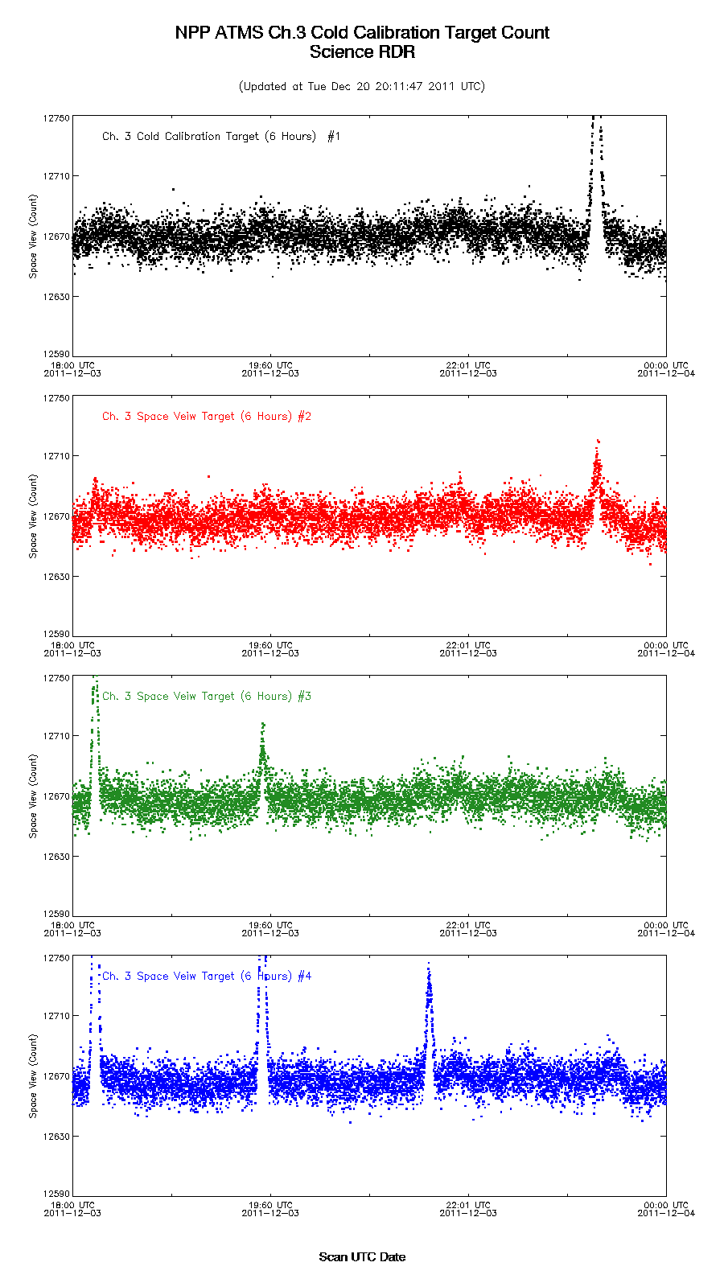
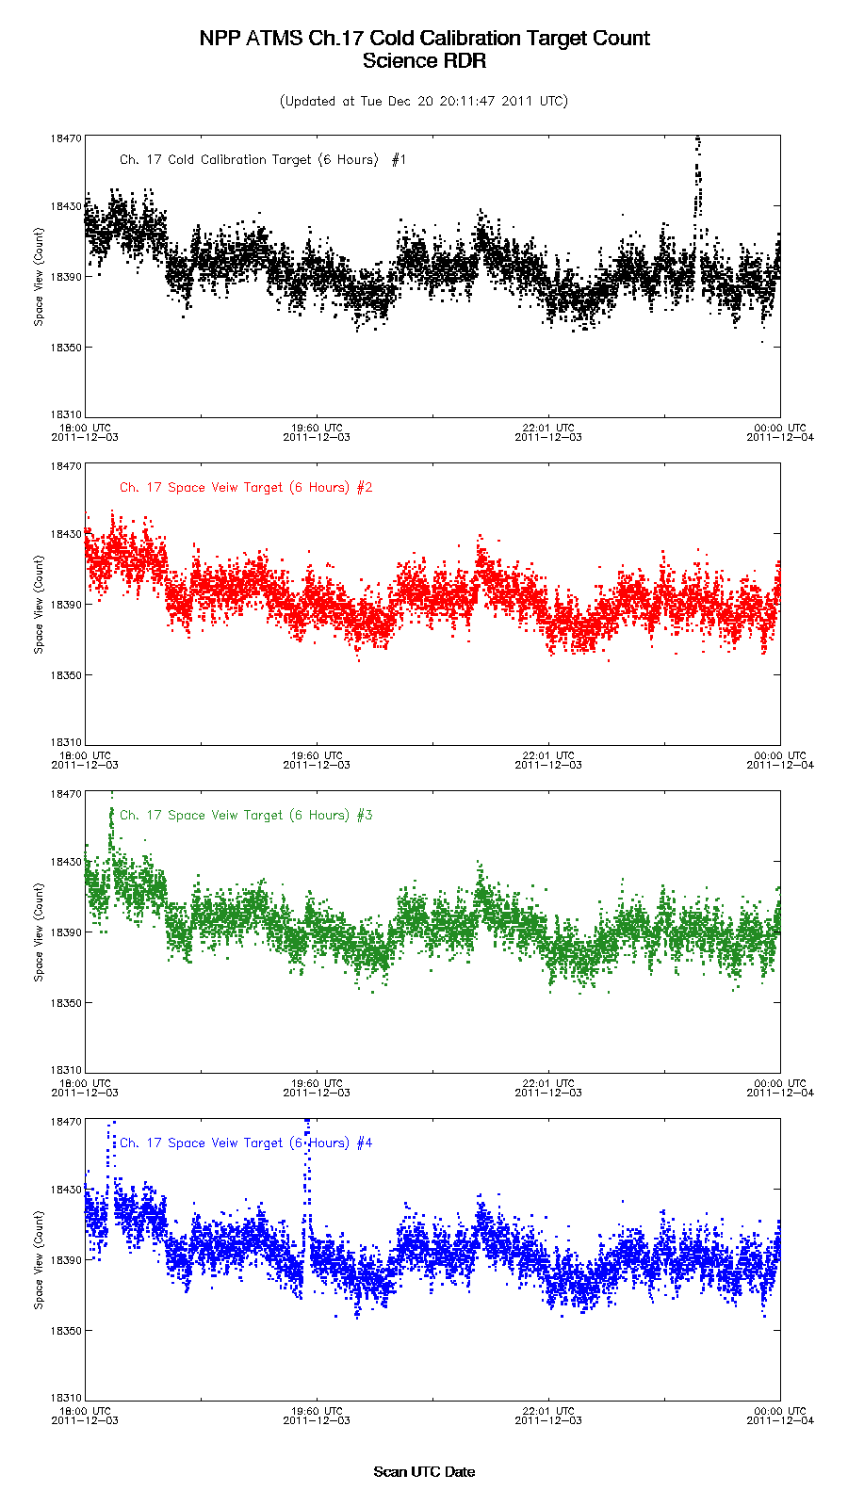
Lunar Intrusion Detection
Channel 1 (FOV Size:5.2)
Channel 3 (FOV Size: 2.2)
Channel 17 (FOV Size: 1.1)
Slide courtesy of STAR

Slide 14
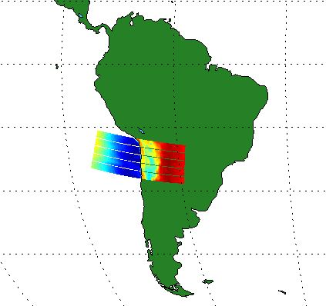
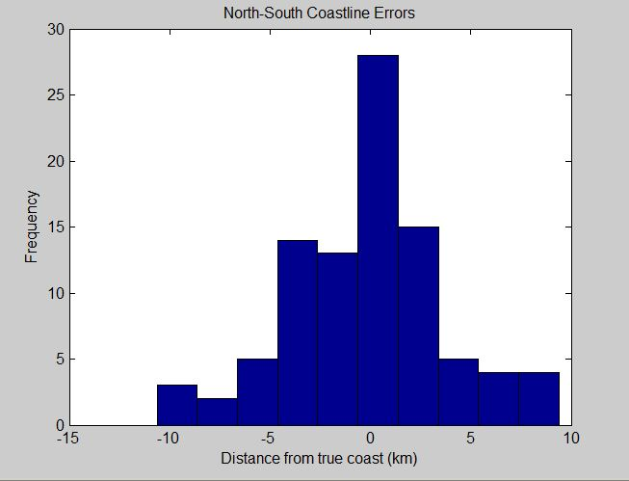
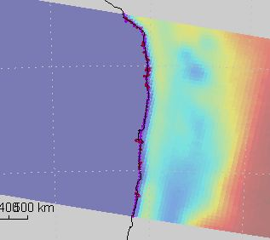
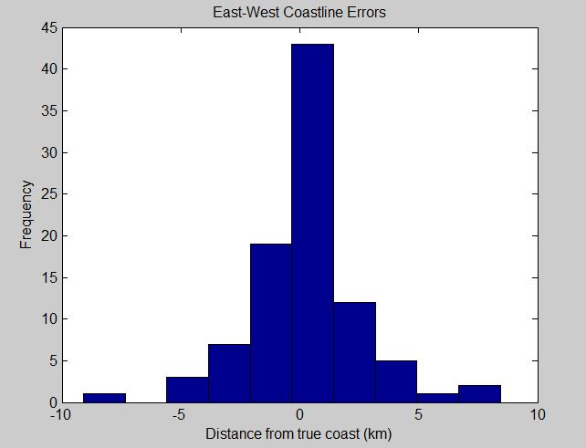
Geolocation Verification
North – South
Mean -0.15km 0.01°
Std. Deviation 3.98km 0.28°
East – West
Mean -.027km 0.02°
Std. Deviation 2.34km 0.16°
Slide courtesy of SDL

Slide 15
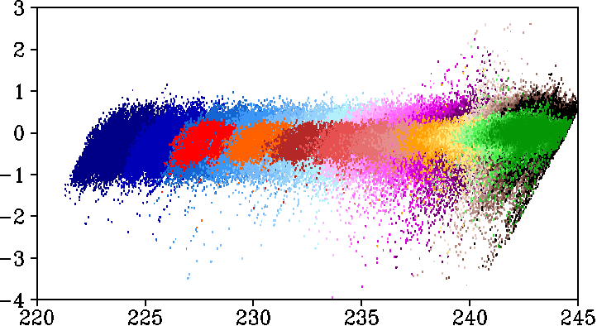
Assessments of ATMS Remap SDR (RSDR)
Channel 7 O-B using GFS
Resampled ATMS has the same bias at all brightness temperatures but much smaller spread (high innovation)
O –B (K)
O (K)
Original ATMS
Remap ATMS
Slide courtesy of STAR

Slide 16
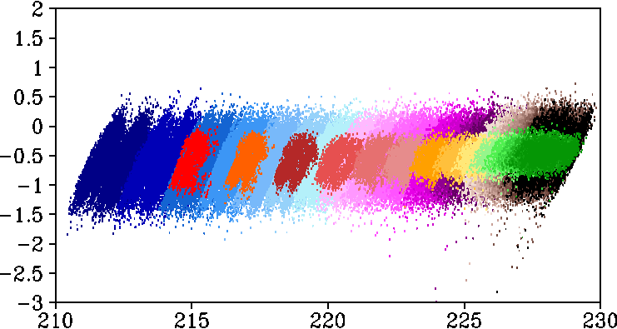
Assessments of ATMS Remap SDR (RSDR)
Channel 8 O-B using GFS
Resampled ATMS has the same bias at all brightness temperatures but much smaller spread (high innovation)
O –B (K)
O (K)
Original ATMS
Remap ATMS

Slide 17
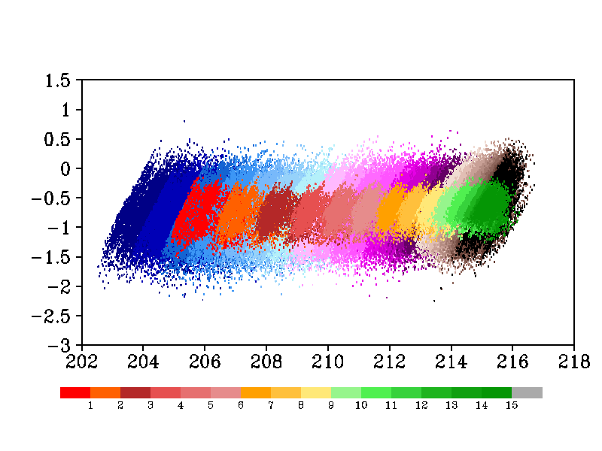
Assessments of ATMS Remap SDR (RSDR)
Channel 9 O-B using GFS
Resampled ATMS has the same bias at all brightness temperatures but much smaller spread (high innovation)
O –B (K)
O (K)
Original ATMS
Remap ATMS

Slide 18
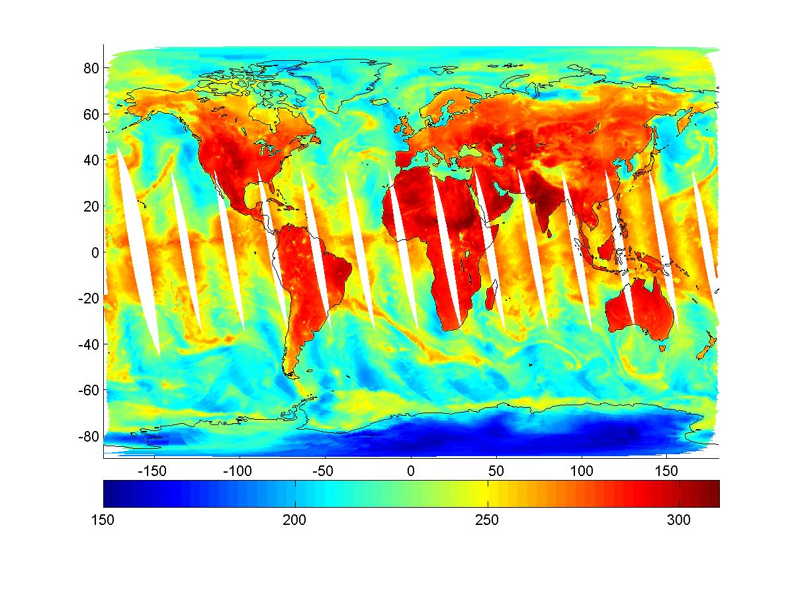

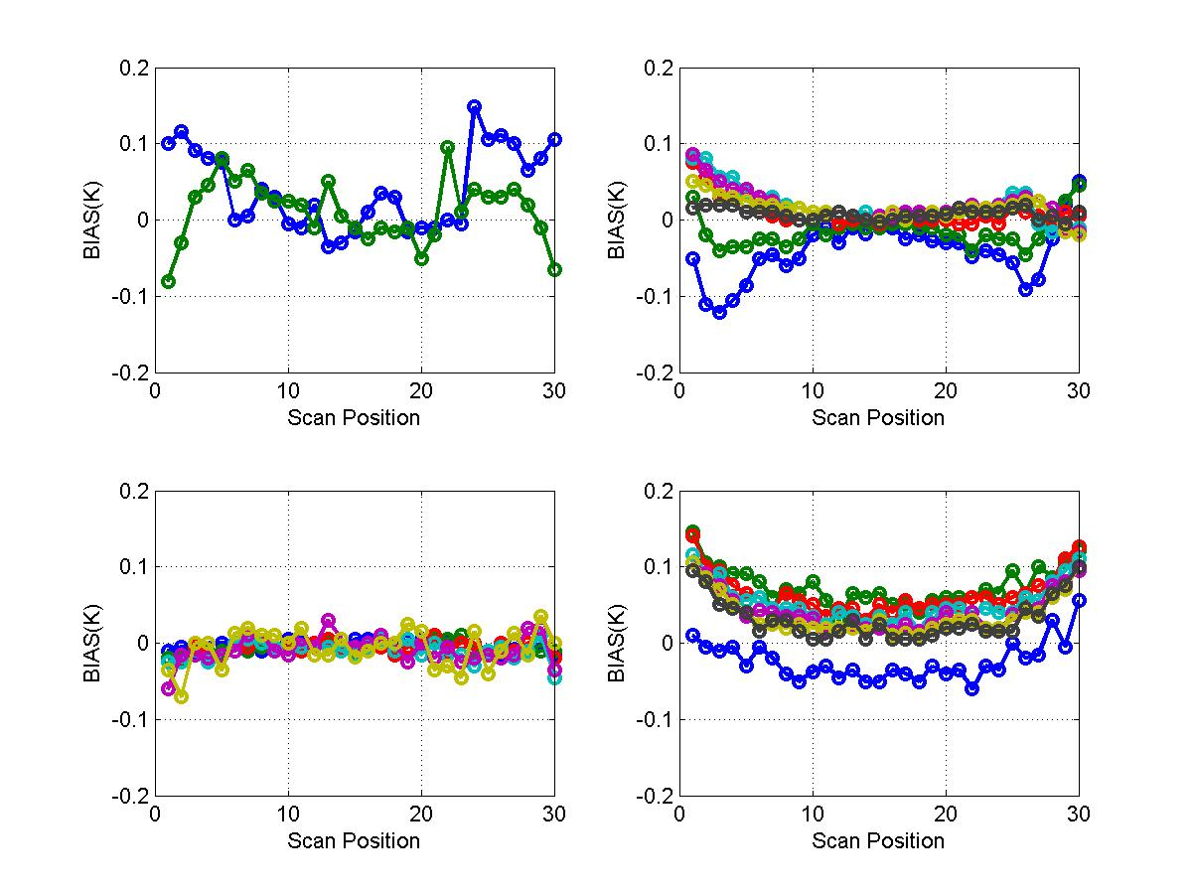
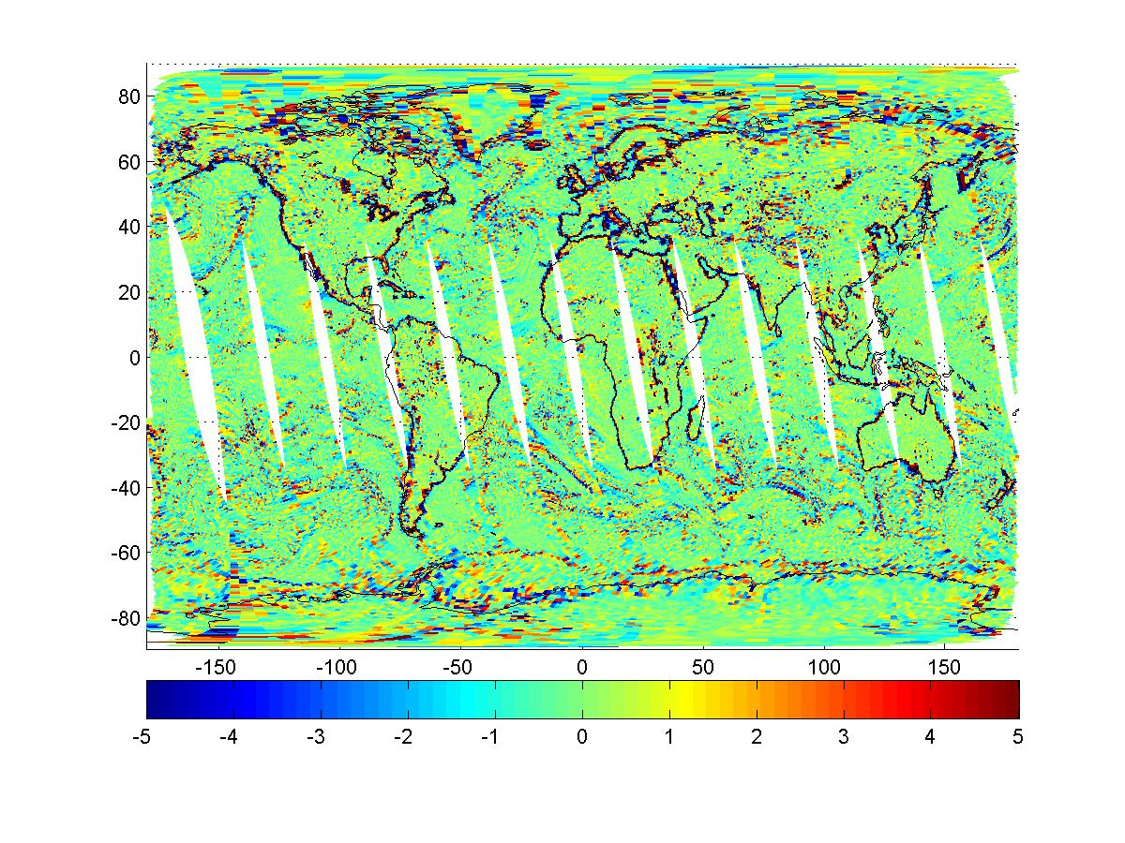
ATMS Remap SDR Evaluation
IDPS Remap SDR (CH 16)
Collocated ATMS SDR (CH 16)
Difference (K)
No Significant Biases Between Remapped SDRs and Collocated ATMS SDRs
Slide courtesy of NGAS

Slide 19
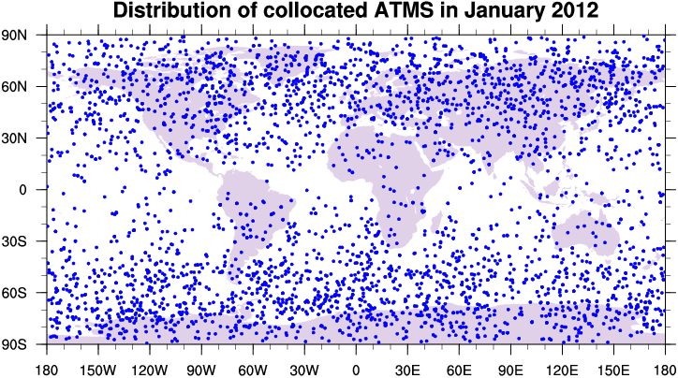
ATMS Calibration Accuracy Assessment Using GPSRO
Time period of data search:
January, 2012
Collocation of CloudSat and COSMIC data:
Time difference < 0.5 hour
Spatial distance < 30 km
(GPS geolocation at 10km altitude is used for spatial collocation)
3056 collocated measurements
Slide Courtesy of STAR

Slide 20
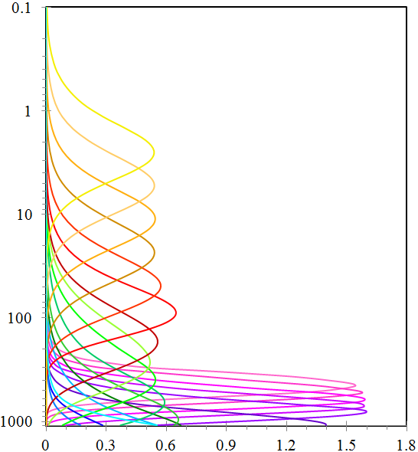
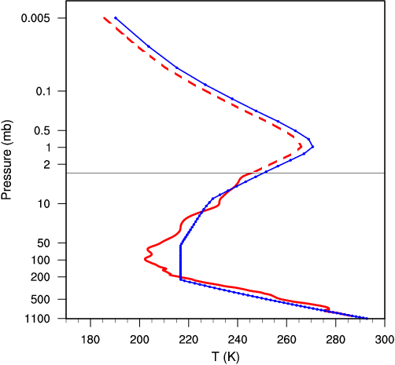


ATMS WF
(U.S. Standard Atmosphere)
Add 1976 U.S. Standard Atmosphere State to GPS Soundings
Pressure (hPa)
GPS Sounding Top
GPS Sounding Top
Weighting Function
1051 UTC on January 1, 2012

Slide 21
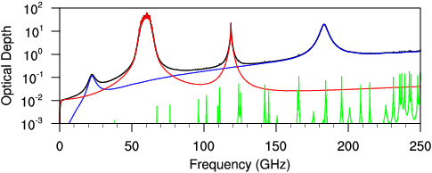
Line by Line RTM
Perform a line by line radiative transfer calculation
Accurate atmospheric spectroscopy data base
Only gaseous absorption
Vertical stratification
all gases
O₂
H₂O
other gases
Microwave sounding channels at 50-60 GHz O₂ absorption band can be best simulated under a cloud-free atmosphere using line by line calculation

Slide 22
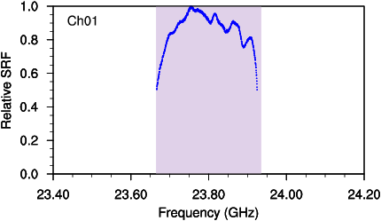
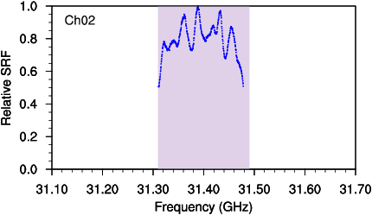
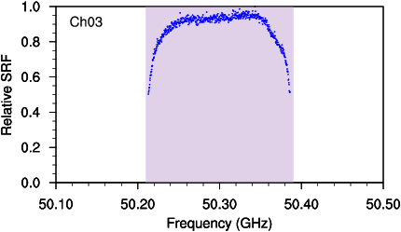
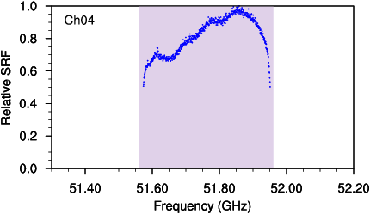
Effects of ATMS Spectral Response Function
Slide courtesy of STAR

Slide 23
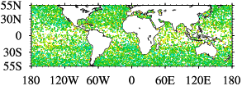
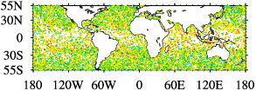
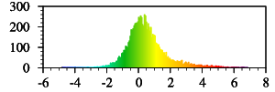
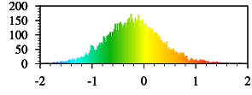
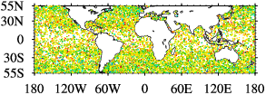
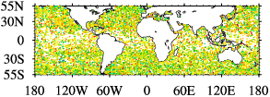
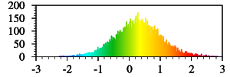
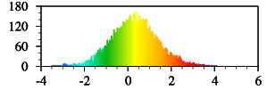
ATMS Bias Obs (TDR) - GPS Simulated
Ch 6
Ch 7
Ch 10
Ch 11
Ch 10
O-GPS (K)
Slide courtesy of STAR
O-GPS (K)

Slide 24
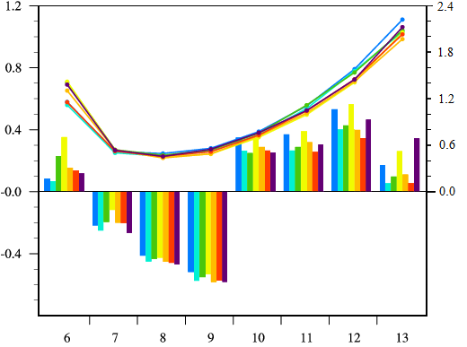
ATMS Bias Obs - Sim (GPSRO)
Std. Dev. (K)
Bias (K)
ATMS Channel
Slide courtesy of STAR

Slide 25
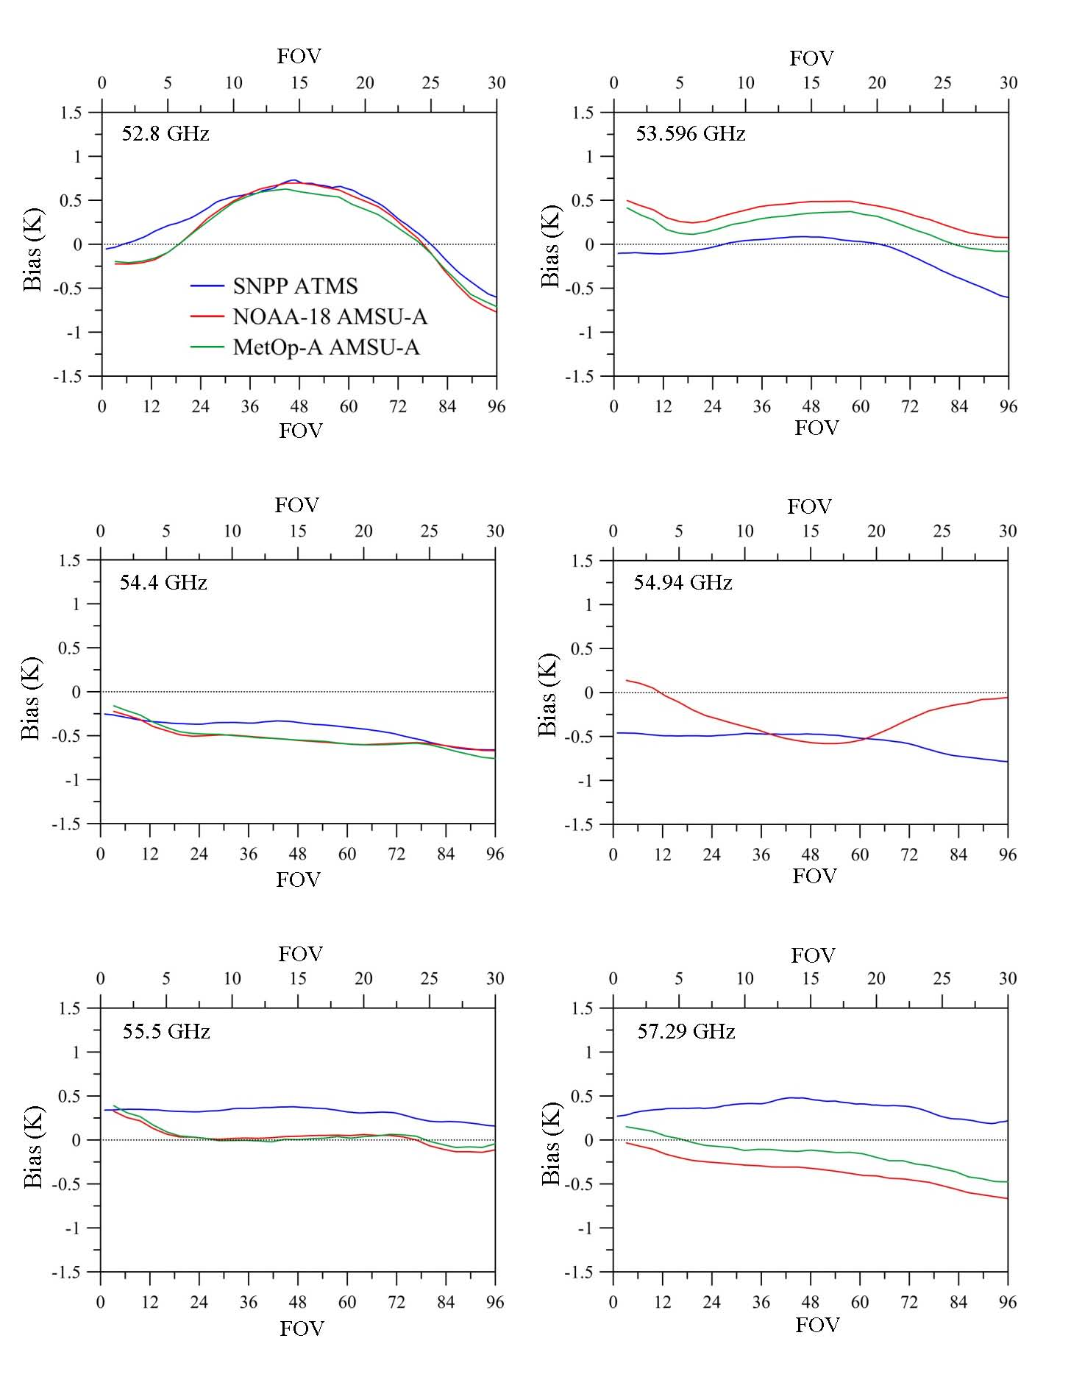
ATMS Bias Compared to AMSU-A
Slide courtesy of STAR

Slide 26
ATMS SDR Algorithm Formulation
SDR
TDR
SDR
Weng et al., 2012, GRSL
The first two terms are Quasi-V and Quasi-H brightness temperature from earth in the main beam (main lobe earth), the 3rd/4th terms are those from the side-lobe earth, the 5/6th terms are the side-lobe cold space, the last term is the near-field satellite radiation
Under a polarized earth scene, the side lobe together with cross-polarization term can result in large errors in computing SDR from TDR data if the antenna has a significant spill-over effect and the cross-polarization term is neglected.

Slide 27
Convertibility Issues from TDR to SDR
Need to correct side-lobe radiation from far-field earth and near-field satellites
For un-polarized surface and atmospheric conditions, the inversion from TDR to SDR is possible with a single polarization measurement.
For an instrument with a significant cross-polarization spill-over, an inversion from TDR to SDR is problematic if a single polarization measurement is available.

Slide 28
ATMS Antenna Beam Efficiency
Frequency (GHz) | (degree) | (%) |  |  | (%) |  |  | (%)
 |  | B1 | B48 | B96 | B01 | B48 | B96 | B01 | B48 | B96
23.8 | 5.25 | 99.48 | 99.61 | 99.53 | 0.52 | 0.39 | 0.46 | 0.003 | 0.0002 | 0.0025
31.4 | 5.35 | 99.59 | 99.60 | 99.60 | 0.40 | 0.40 | 0.39 | 0.003 | 0.0003 | 0.0024
50.3 | 2.20 | 99.43 | 99.39 | 99.56 | 0.57 | 0.61 | 0.44 | 0.001 | 0.0006 | 0.0008
51.8 | 2.25 | 99.45 | 99.47 | 99.73 | 0.55 | 0.53 | 0.27 | 0.001 | 0.0004 | 0.0007
52.8 | 2.25 | 99.48 | 99.46 | 99.36 | 0.51 | 0.54 | 0.64 | 0.001 | 0.0004 | 0.0010
53.6 | 2.20 | 99.49 | 99.43 | 99.31 | 0.51 | 0.57 | 0.68 | 0.001 | 0.0004 | 0.0008
54.4 | 2.15 | 99.51 | 99.51 | 99.55 | 0.49 | 0.49 | 0.44 | 0.001 | 0.0006 | 0.0006
54.9 | 2.20 | 99.48 | 99.49 | 99.21 | 0.51 | 0.51 | 0.78 | 0.001 | 0.0004 | 0.0007
55.5 | 2.15 | 99.50 | 99.52 | 99.54 | 0.50 | 0.48 | 0.46 | 0.001 | 0.0004 | 0.0007
57.3 | 2.20 | 99.48 | 99.49 | 99.48 | 0.52 | 0.51 | 0.52 | 0.001 | 0.0006 | 0.0007
88.2 | 2.05 | 97.73 | 97.70 | 97.92 | 2.27 | 2.30 | 2.07 | 0.002 | 0.0012 | 0.0035
166.5 | 1.16 | 98.00 | 97.77 | 96.92 | 1.98 | 2.21 | 3.06 | 0.013 | 0.0147 | 0.0085
176.31 | 1.10 | 97.92 | 97.77 | 96.17 | 2.07 | 2.21 | 3.81 | 0.009 | 0.0115 | 0.0075
183.31 | 1.10 | 97.69 | 98.48 | 98.86 | 2.29 | 1.50 | 1.12 | 0.009 | 0.0108 | 0.0083
190.31 | 1.07 | 98.23 | 97.94 | 97.80 | 1.75 | 2.03 | 2.18 | 0.011 | 0.0138 | 0.0111
From STAR’ calculation

Slide 29
ATMS SDR Algorithm
For Quasi-V :
For Channels 1, 2, 16
For Quasi-H:
For Channels 4~15, and 17~22
Caveats: Cross-polarization spill-over is neglected. The main contribution from the side-lobe earth is next to the main beam. Atmosphere is also unpolarized and both side-lobe earth and spill-over are included in the main beam efficiency which is close to 1.0

Slide 30
Status of ATMS Discrepancy Reports
25 DRs Opened
9 DRs Closed
3 DRs remain open for provisional version
4811 - PRT consistency check (analysis is done in ADL4.0)
4593 – ATMS DQTT (draft values accepted, RTN will test)
4806 – Scan bias correction (convertibility theory/draft values proposed )
12 DRs remain open for validated version

Slide 31
Lesson Learned from NPP ATMS
Uncertainty in the current ATMS radiometric calibration
Uses of Rayleigh-Jeans approximation result in significant uncertainty in calibration although empirical corrections are applied
Uncertainty related to ATMS antenna cross polarization
Current ATMS antenna has 1 to 2% cross-polarization spill-over for some channels. Over oceans where the surface is polarized, TDR to SDR conversion would have a large uncertainty due to neglecting cross-pol spill-over
Uses of Backus-Gilbert for channel 1 to 2 enhancement
ATMS noise is very low and the FOV enhancements for ch 1 and 2 seem to be likely for better depicting the storm structure
Channel dependent calibration procedure for reducing the striping
Need to further reduce the ATMS striping for the upper-level channels

Slide 32
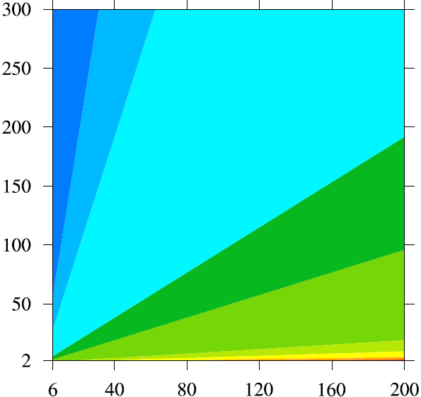

ATMS Radiometric Calibration Using Rayleigh-Jeans (RJ) Approximation: Ill-Posted Approach in IDPS
T (K)
When
Frequency (GHz)
In ATMS frequency range , this condition is not valid in cold space view !

Slide 33
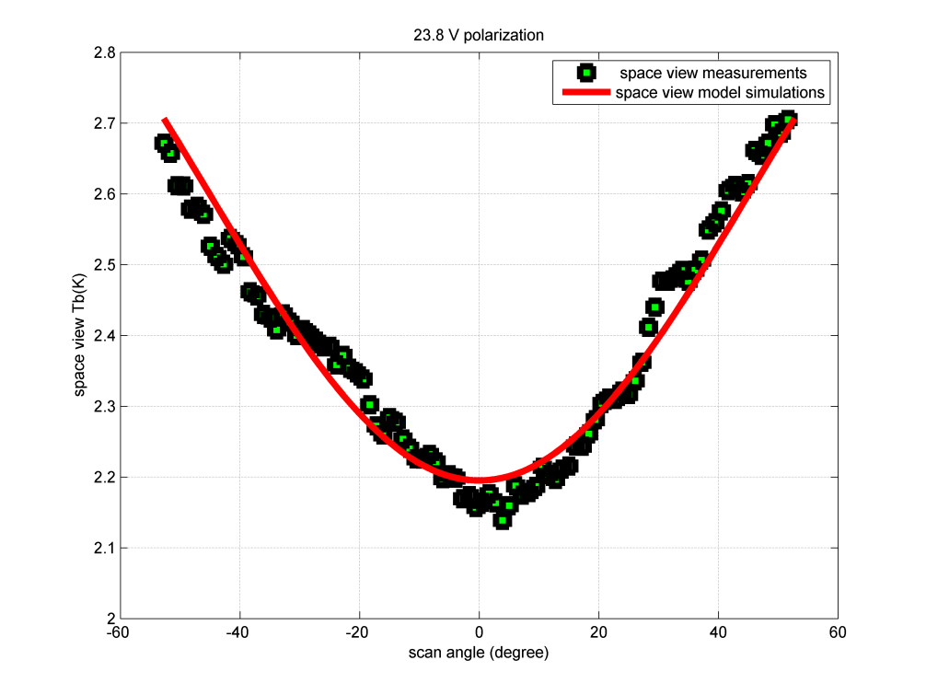
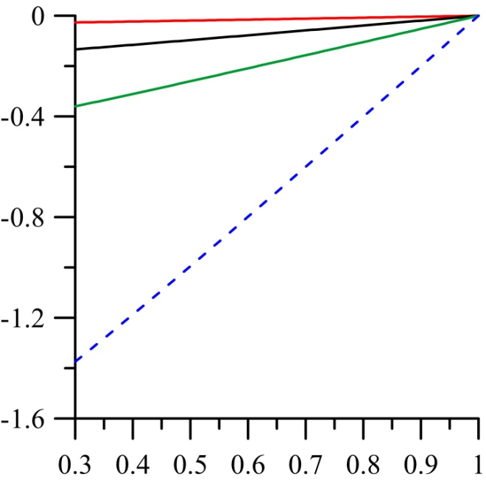


ATMS Radiometric Calibration Errors from RJ vs. Pitch Maneuver Data
Error from RJ Approximation
ATMS Pitch Maneuver Data
It is a mystery why Tb is significantly than 2.73K. The bias is due probably to uses of Rayleigh Jeans approximation
Slide courtesy of STAR

Slide 34
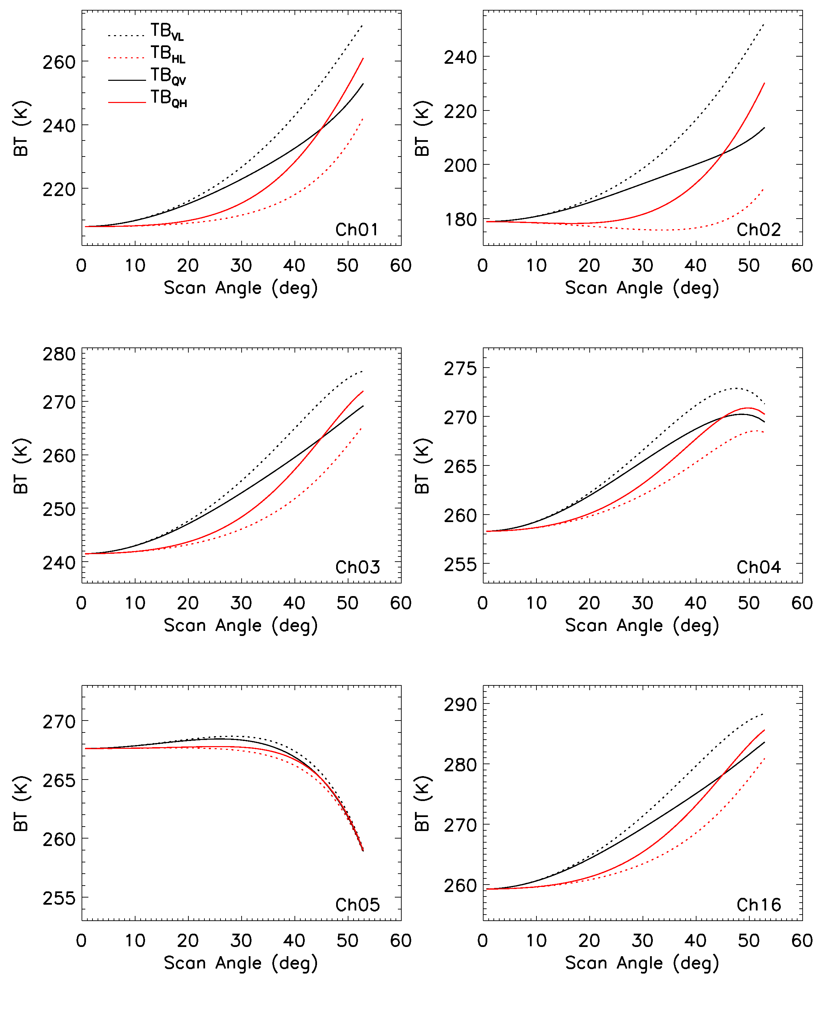
Brightness Temperatures Simulated over Oceans
For a scan angle ranging from 15 to 45 degrees, ATMS brightness temperatures at ch1, 2, 3,4 and 16 are polarized over oceans. A conversion from TDR to SDR is also ill-posted problem if the antenna has a significant spill-over effect
Slide courtesy of STAR

Slide 35
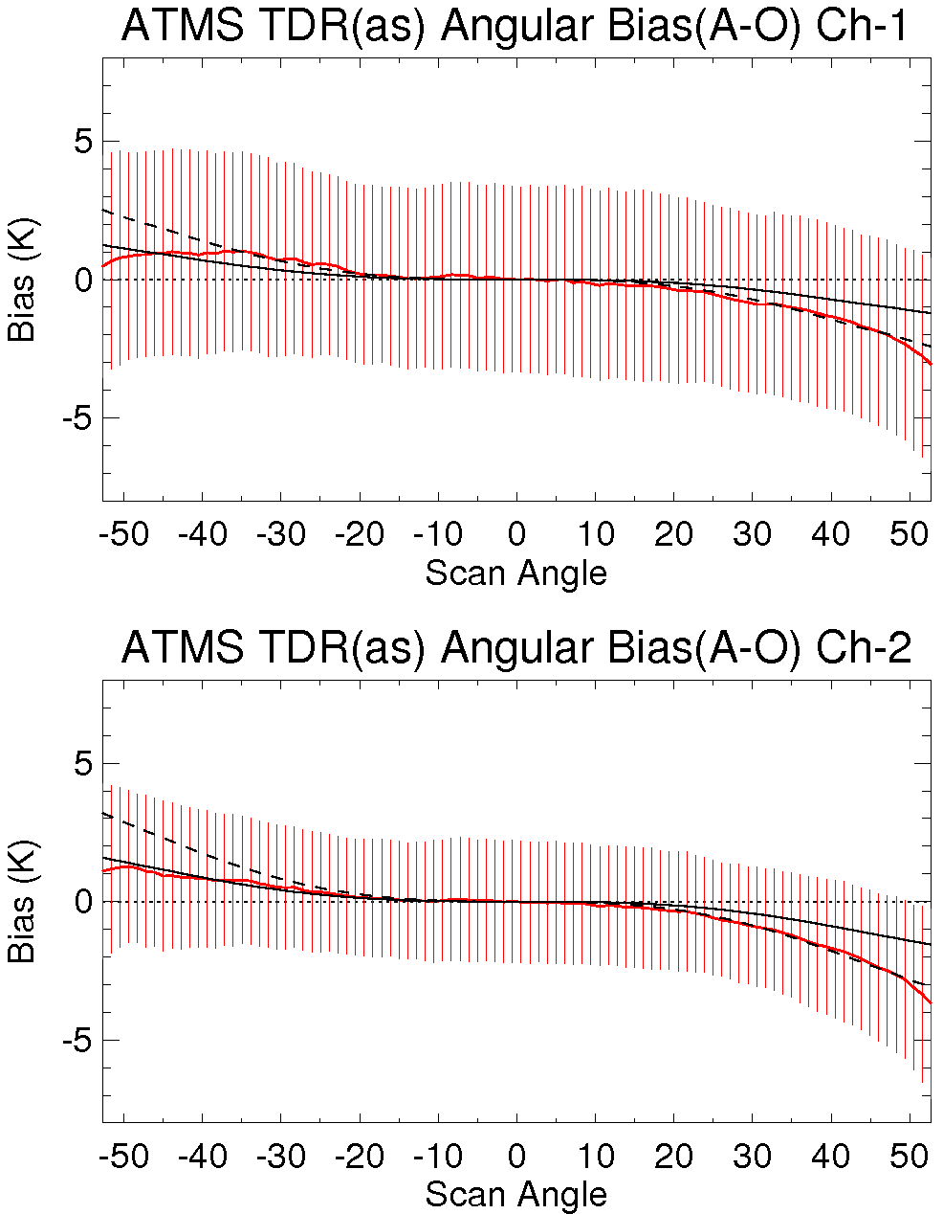
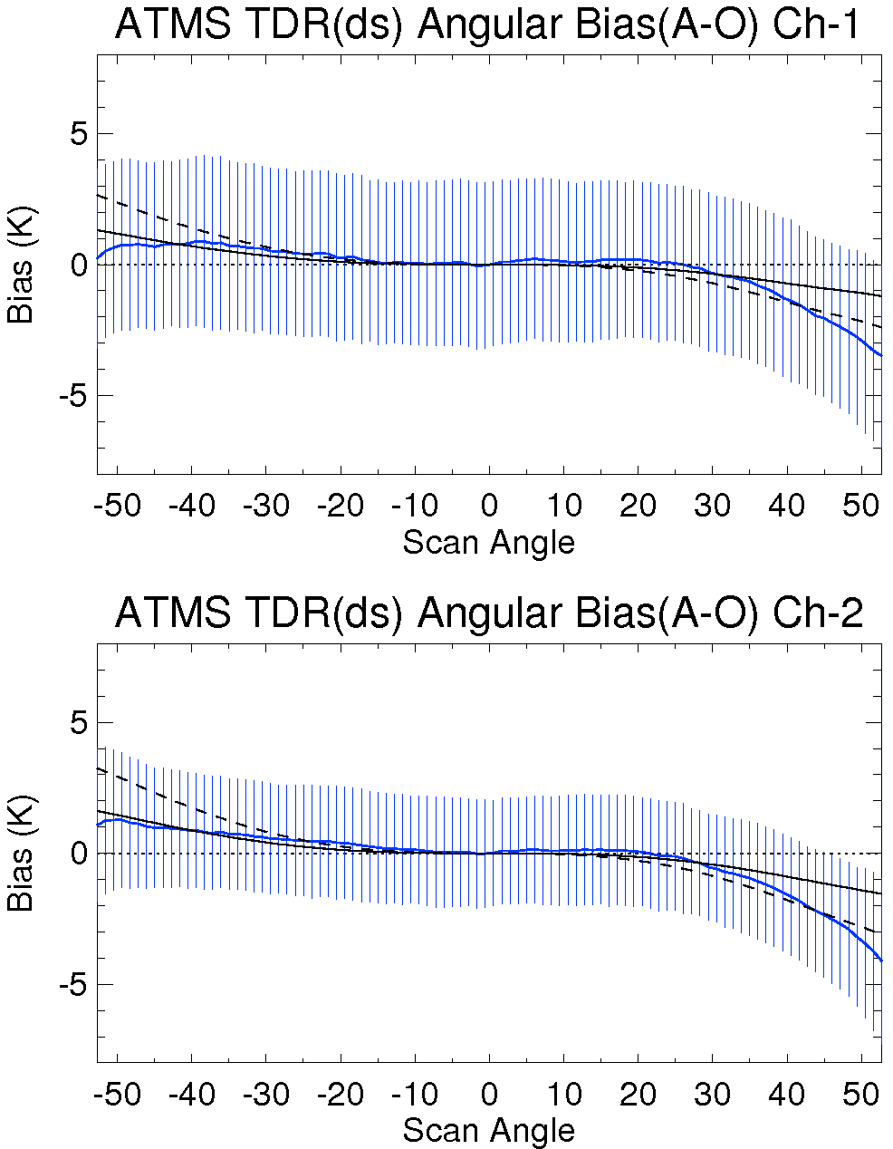
ATMS Polarization Twist Angle
Angular dependent bias (A-O) Dec, 16-22, 2011
CRTM Sim: GSI analysis field ; OBS: ATMS TDR
____ 91º misalignment
---- 92º misalignment
2 degree misalignment
1 degree misalignment
Slide courtesy of STAR

Slide 36
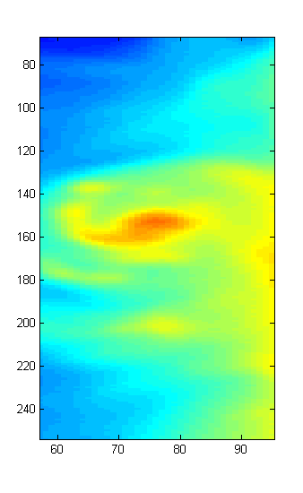
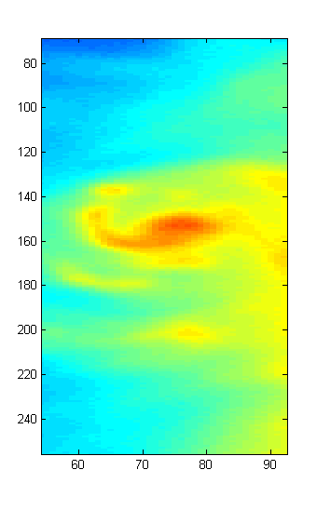
ATMS De-convolution from Low to High Resolution
Raw 23 Tb (5.2 degree)
Resampled 23 Tb( 2.2 degree)
Slide courtesy of STAR

Slide 37
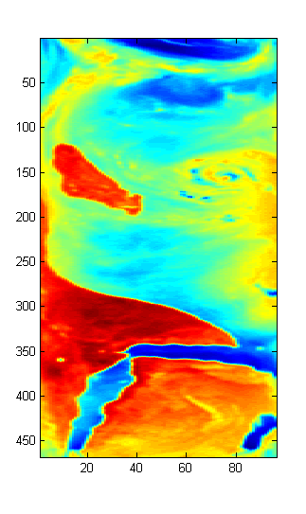
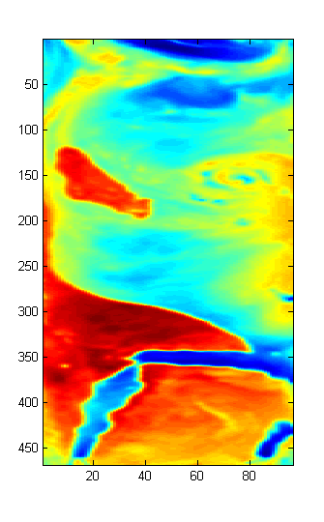
ATMS Convolution from High to Low Resolution
Raw 89 GHz Tb (2.2 degree)
Resampled 89 Tb( 5.2 degree)
Slide courtesy of STAR

Slide 38
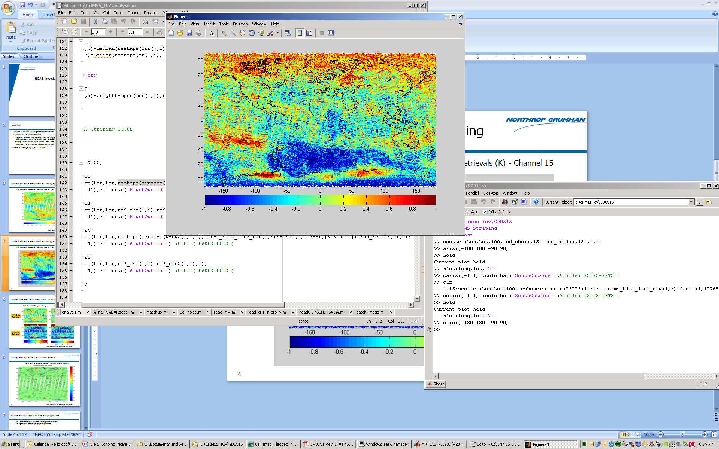
ATMS TDR Stripping Noise
Striping is caused by ATMS SDR calibration noise, specifically the noise in the warm counts. Contributions to the overall calibration noise from cold counts and PRT readings are much smaller
The level of the striping noise is insignificant and well within ATMS SDR noise spec level
ATMS Brightness Temperature Difference: Simulated – Observed
NPP SNO w/ AQUA
2 Nov 2011 21:17:40.000
Slide courtesy of NGAS

Slide 39
Path Forward
Update ATMS scan bias corrections for TDR to SDR conversion using the ATMS antenna efficiency and pitch maneuver data
Work with NGES to better characterize ATMS antenna (side-lobe, xpol spill-over, polarization twist angle) for J1/J2 mission
Revise ATMS radiometric calibration in full radiance to make the SDR data consistent with NOAA heritage approach
Develop channel-dependent averaging of warm counts for reducing stripping

Slide 40
Summary
ATMS TDR/SDR data has reached a provisional status.
NEDT (precision) at 22 channels meet specification
Bias (accuracy) at channels 5 to 13 are better than specification
ATMS TDR to SDR conversion theory is well developed and applied for TDR to SDR conversion
Caveats : xpol spill-over is neglected for window channels. Performance is not optimal for clear oceans where there is significant polarization
ATMS radiometric calibration theory needs to be further improved with full radiance processing

